Slide 1
MHRN1 Suicide Risk Prediction Project
4 MHRN health systems (GH, KPSC, KPCO, HealthPartners)
Approx. 1.2 million PHQ9 observations for 250k patients
Focus on prediction by response to PHQ9 item 9
Publications:
  Risk of suicide attempt and suicide death following completion of the Patient Health Questionnaire depression module in community practice. J Clin Psychiatry 2016; 77:221.
  Suicidal Ideation Reported on the PHQ9 and Risk of Suicidal Behavior across Age Groups. J Affect Disord (in press).
  Between-visit changes in suicidal ideation and risk of subsequent suicide attempt. Depress Anxiety (in press).
  Suicidal Ideation as Measured by the PHQ9 in Elderly or Medically Ill Patients. – revision under review
  Predicting Fatal and Non-fatal Suicide Attempt Among Adolescents Using Item 9 of the PHQ9. - resubmitted
  Positive Screening for Suicidal Ideation and Risk for Subsequent Suicide Attempt in Different Racial and Ethnic Groups. – revision under review

Slide 2
Suicide Prevention Outreach Trial summary
Demonstration project of the NIH Healthcare Systems Research Collaboratory
Pragmatic trial of two outreach interventions to reduce long-term risk of suicide attempt
Automatically enroll health system patients who report frequent thoughts of death or self-harm
Randomly assign to continued usual care or to one of two outreach-based interventions
Examine risk of suicide attempt over 12-18 months after randomization
Planned sample size = 19,500 (6500 per group)

Slide 3
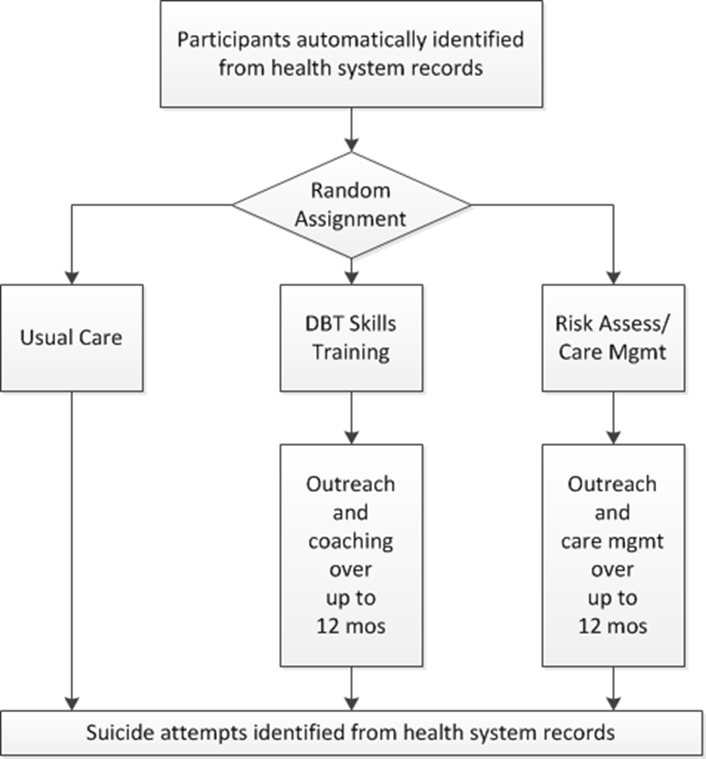
Intervention Research: Pragmatic trial of population-based selective prevention programs (funded by NIH Collaboratory)
Ongoing at four MHRN sites:
KP Washington
HealthPartners
KP Colorado
KP Northwest
13,000 enrolled to date

Slide 4
Intervention programs
Dialectical Behavior Therapy Skills Training
  Specific emotion regulation skills found to reduce risk of repeat suicide attempt
  Delivered via interactive online program
  Supported by an online health coach
Risk Assessment and Care Management
  Systematic outreach to assess acute risk
  Care management to facilitate/maintain appropriate contact with outpatient mental health care
Both interventions designed to limit cost to <$100 per patient

Slide 5
MHRN2 Suicide Risk Calculator Project
Settings: Group Health, HealthPartners, Henry Ford, KP Colorado, KP Hawaii, KP Northwest, KP Southern California
Sample: Age >=13, Visit to Specialty MH OR Prim Care with MH Dx
Outcomes: Suicide attempt or suicide death in 90 days
Approximately 160 Predictors and selected interactions:
  Demographics (age, sex, race/ethnicity, neighborhood SES)
  MH and SUD diagnoses (current, recent, last 5 yrs)
  Psychiatric medication dispensings (current, recent, last 5 yrs)
  Co-occurring medical conditions (per Charlson index)
  PHQ item 9 scores (current, recent, ever)
  PHQ8 scores (current, recent, ever)

Slide 6
Sample description:
19.6 million visits for approx. 2.9 million people
51% MH specialty and 48% primary care
Race/Ethnicity: 14% Hispanic, 9% African American, 5% Asian
Insurance source: 5% Medicaid, 20% Medicare
Diagnoses: 1.5 million Bipolar Disorder, 690K Schizophrenia/Psychosis
1.9 million have PHQ item 9 score recorded
24,000 visits followed by suicide death (2108 unique events)
440,000 visits followed by suicide attempt (29,423 unique events)

Slide 7
Predicting suicide attempt in 90 days: top 15 predictors:
SUICIDE ATTEMPT FOLLOWING MENTAL HEALTH SPECIALTY VISIT | SUICIDE DEATH FOLLOWING MENTAL HEALTH SPECIALTY VISIT
Depression diagnosis in last 5 yrs. | Suicide Attempt in last 3 mos
Age 13-17 and female | Benzodiazepine Rx in last 3 mos
Drug Abuse diagnosis in last 5 yrs. | Mental Health ER visit in last 3 mos
PHQ9 Item 9 score =3 in last year | 2nd Gen Antipsychotic Rx in last 5 years
Alcohol Use Disorder Dx in last 5 yrs | Mental Health inpatient stay in last 5 years
Mental health inpatient stay in last yr. | Mental Health ER visit in last year
Benzodiazepine Rx. in last 3 mos. | Mental Health inpatient stay in last 3 mos
Suicide attempt in last 3 mos. | Alcohol Use Disorder Dx in last 5 years
Personality disorder diag. in last 5 yrs. | Antidepressant Rx in last 3 mos
Eating Disorder diagnosis in last 5 yrs. | PHQ9 Item 9 score = 3 at index visit
Suicide attempt in last 5 years. | PHQ9 item 9 score = 2 at index visit
Mental Health ER visit in last 3 mos. | Depression Dx in last 5 years
Suicide attempt in last 5 yrs. | Anxiety Diagnosis in last 5 years
Anxiety Disorder diag. in last 5 yrs. | Bipolar Dx in last 5 years
Any Injury/Poisoning Dx in last 3 mos. | Schizophrenia Dx in last 5 years

Slide 8
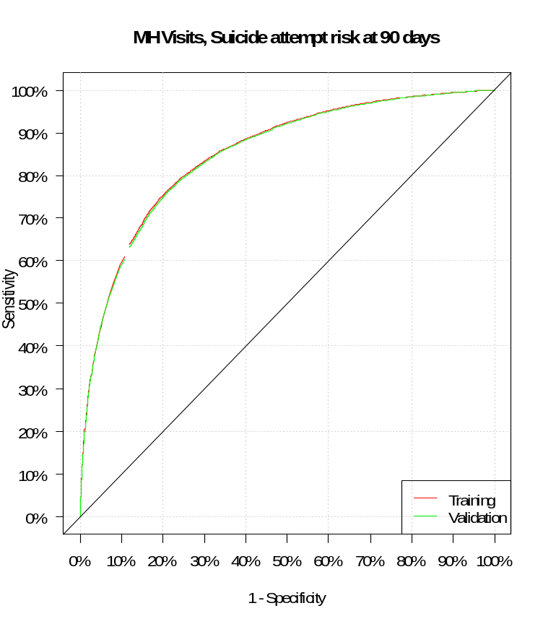
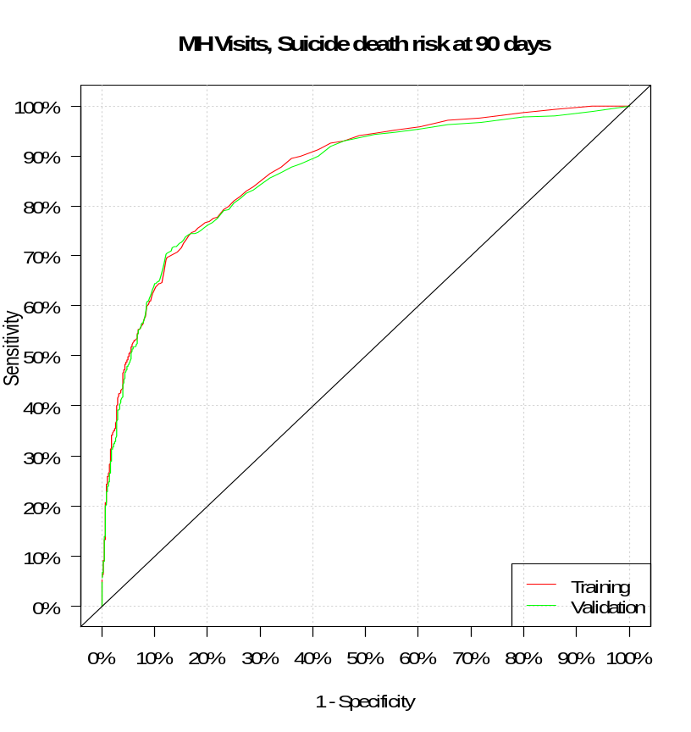
Predicting suicidal behavior in 90 days (MH Specialty)
AUC=0.850
AUC=0.861

Slide 9
Secondary/Subgroup Analyses:
Suicidal behavior in perinatal period
Risk model specific to adolescents
Significance of PHQ9 item 9 in psychotic disorders
Predictors in people with substance use disorders
Agreement/disagreement between PHQ9 screening and computed risk scores

Slide 10
New work underway:
Pilot implementation in MH specialty clinics (KPWA)
Refresh and expand dataset
  Extend visit sample through 2016
  Cohorts of ED visits and MH hospital discharges
  Increase proportion with PHQ9 data
  More detail regarding timing of prediction events
New modeling methods (CART, Random Forest)

